Slide 1
Aggregation Framework

Slide 2
Aggregation Example
Using the zips collection, find all zips with population >= 10000
db.zips.find( {pop: {$gte: 10000}})

Slide 3
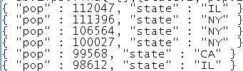

Aggregation Framework
State-wise count of ZIP codes
db.zips.aggregate (
{$group:
{_id: '$state',
zip_count: {$sum: 1}}}
)

Slide 4
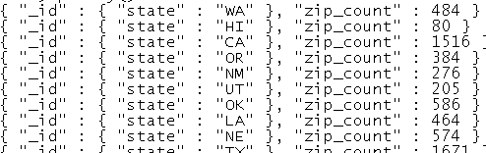
Aggregation Framework
Alternatively:
db.zips.aggregate (
{$group:
{_id: {state: '$state'},
zip_count: {$sum: 1}}}
)

Slide 5
Aggregation Framework
Sort the above in descending order of zip_count
db.zips.aggregate (
{$group:
{_id: '$state', zip_count: {$sum: 1}}},
{$sort: {zip_count: -1}}
)
Sort the above in ascending order of state code
db.zips.aggregate (
{$group:
{_id: '$state', zip_count: {$sum: 1}}},
{$sort: {_id: 1}}
)

Slide 6
Aggregation Pipeline
Operator | What it does | In : Out
$project | Reshape the document | 1: 1
$match | Filter | N : 1
$group | Aggregate (e.g., count, sum) | N : 1
$sort | Sort | 1 : 1
$skip | Skip documents | N : 1
$limit | Limit the number of documents | N : 1
$unwind | Normalize (flatten) the data | 1 : N
$out | Store the result in a named collection | 1 : 1
$lookup | Left outer join | 1 : 1

Slide 7
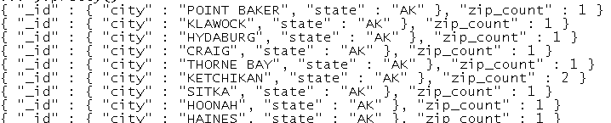
Compound Grouping
For each city (with state code), get the count of zip codes.
db.zips.aggregate (
{$group:
{_id: {city: '$city', state: '$state'},
zip_count: {$sum: 1}}}
)

Slide 8
Aggregation Framework
State-wise sum of population
db.zips.aggregate (
{$group:
{_id: '$state',
population: {$sum: '$pop'}}}
)
Sort the above in descending order of population
db.zips.aggregate (
{$group:
{_id: '$state',
population: {$sum: '$pop'}}},
{$sort: {population: -1}}
)

Slide 9
Aggregation Framework
Sort the above in ascending order of state code
db.zips.aggregate (
{$group:
{_id: '$state',
population: {$sum: '$pop'}}},
{$sort: {_id: 1}}
)
Limit the above to states with population >= 10 million
db.zips.aggregate (
{$group:
{_id: '$state',
population: {$sum: '$pop'}}},
{$match: {population: {$gte: 10*1000*1000}}},
{$sort: {_id: 1}}
)

Slide 10
Aggregation Expressions in $group
$sum
$avg
$min
$max
$addToSet
$push
$first
$last

Slide 11
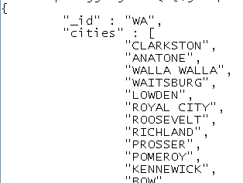
$group: $addToSet
List of cities for each state:
db.zips.aggregate (
{$group:
{_id: '$state',
cities: {$addToSet: '$city'}}}
).pretty()

Slide 12
$push
Similar to $addToSet, but duplicate values are possible within the collection with $push.

Slide 13
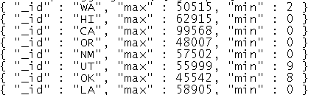
$max, $min
For each state print the population of the zip code with the highest population in each state.
db.zips.aggregate (
{$group: {_id: '$state', pop: {$max: '$pop'} } }
)
Also include the minimum population in the above result
db.zips.aggregate (
{$group: {_id: '$state', max: {$max: '$pop'},
min: {$min: '$pop'} } }
)

Slide 14
$project
Purpose: to reshape a document.
Examples:
Remove keys
Add keys
Transform keys
$toUpper
$toLower
$add
$multiply

Slide 15
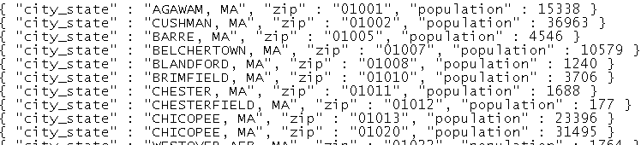
$project
Transform the data with city + state, zip, population fields
db.zips.aggregate (
{$project: {_id: 0, city_state: {$concat: ['$city', ', ', '$state'] }, zip: '$_id', population: '$pop' } }
)

Slide 16
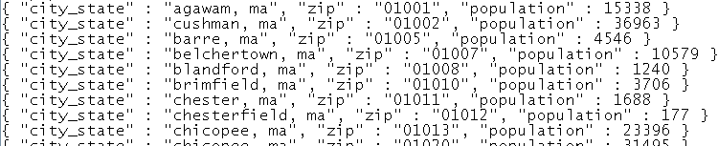
$project
Same as previous, but with city + state converted to lower case
db.zips.aggregate (
{$project: {_id: 0, city_state: {$toLower: {$concat: ['$city', ', ', '$state'] } }, zip: '$_id', population: '$pop' } }
)

Slide 17
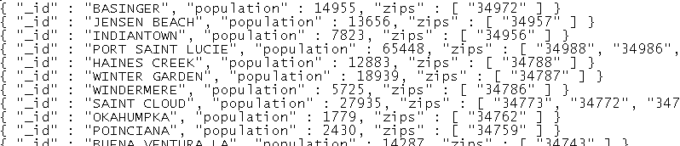
$match
For the state of Florida, get city-wise population and list of zip codes
db.zips.aggregate (
{$match: {state: 'FL'} },
{$group:
{_id: '$city',
population: {$sum: '$pop'},
zips: {$addToSet: '$_id'} } } )

Slide 18
$match
Sort the above in descending order of population
db.zips.aggregate (
{$match: {state: 'FL'} },
{$group: {_id: '$city',
population: {$sum: '$pop'},
zips: {$addToSet: '$_id'} } },
{$sort: {population: -1} }
)

Slide 19
$sort
By default, up to 100MB of sorting performed in memory; larger sorts on disk.
Just sorting by state name, city name (both ascending)
db.zips.aggregate (
{$sort: {state: 1, city: 1} }
)

Slide 20
$skip, $limit
db.zips.aggregate (
{$sort: {state: 1, city: 1} },
{$skip: 3},
{$limit: 2}
)

Slide 21
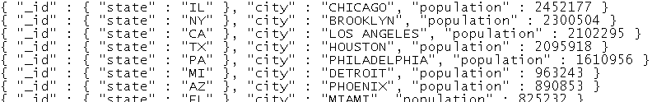
$first
State-wise list of the city with largest population
db.zips.aggregate (
{$group: {_id: {state: '$state', city: '$city'},
population: {$sum: '$pop'} } },
{$sort: {'_id.state': 1, population: -1} },
{$group: {_id: {state: '$_id.state'},
city: {$first: '$_id.city'},
population: {$first: '$population'}} },
{$sort: {population: -1} }
)

Slide 22
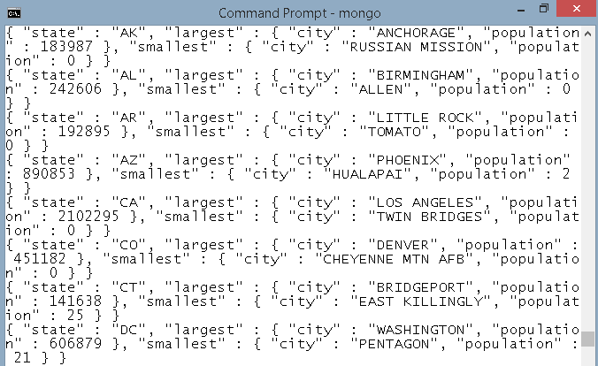
Exercise
Print state-wise list of cities with largest and smallest populations. The output may look like this:

Slide 23
Exercise
State-wise count of cities with zero population, in descending order of count of cities.

Slide 24
$unwind
{z: 1, a: [1, 2, 3]}
$unwind will convert to:
{z: 1, a: 1}
{z: 1, a: 2}
{z: 1, a: 3}

Slide 25
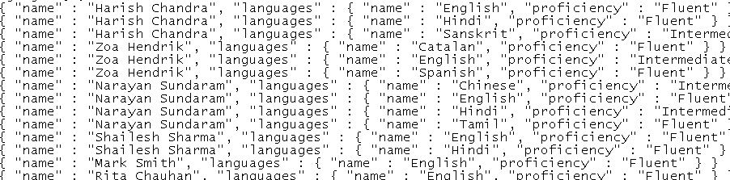
$unwind
db.persons.aggregate (
{$project: {_id: 0, name: {$concat:
['$name.first', ' ', '$name.last']},
languages: 1 } },
{$unwind: '$languages'}
)

Slide 26
Repeated $unwind for Cartesian Product
{product: “abc”,
colors: [‘red’, ‘black, ‘blue’],
sizes: [‘small’, medium’, large’, ‘extra large’]
}
{$unwind: ‘$colors’},
{$unwind: ‘$sizes’}
will produce 12 documents from the one given above.

